Slide 1
InfraBIM Guidelines in Finland
Geotechnical Data Standardization Workshop 22.-23.1.2019
Juha Liukas
Leading consultant, InfraBIM Sitowise
Chair of Infra standardizartion group, buildingSMART Finland

Slide 2

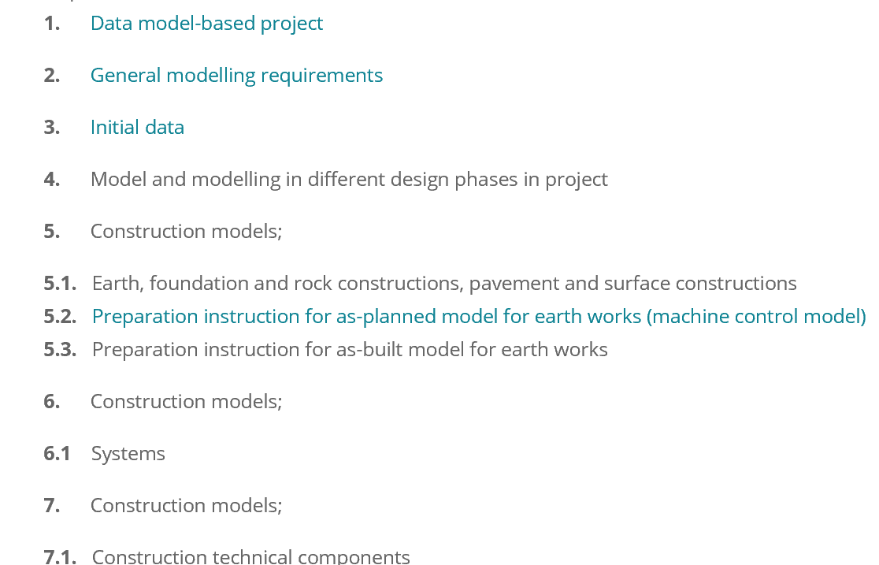
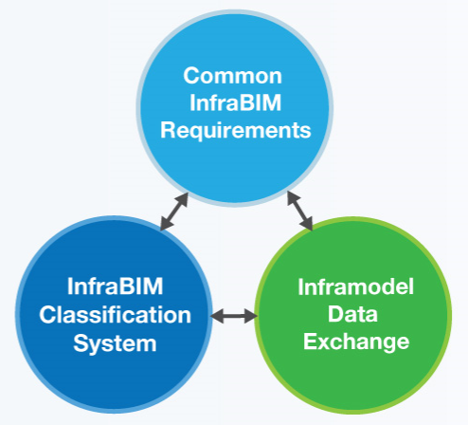
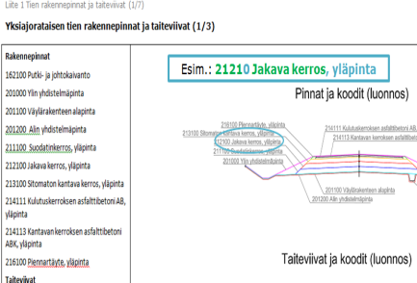
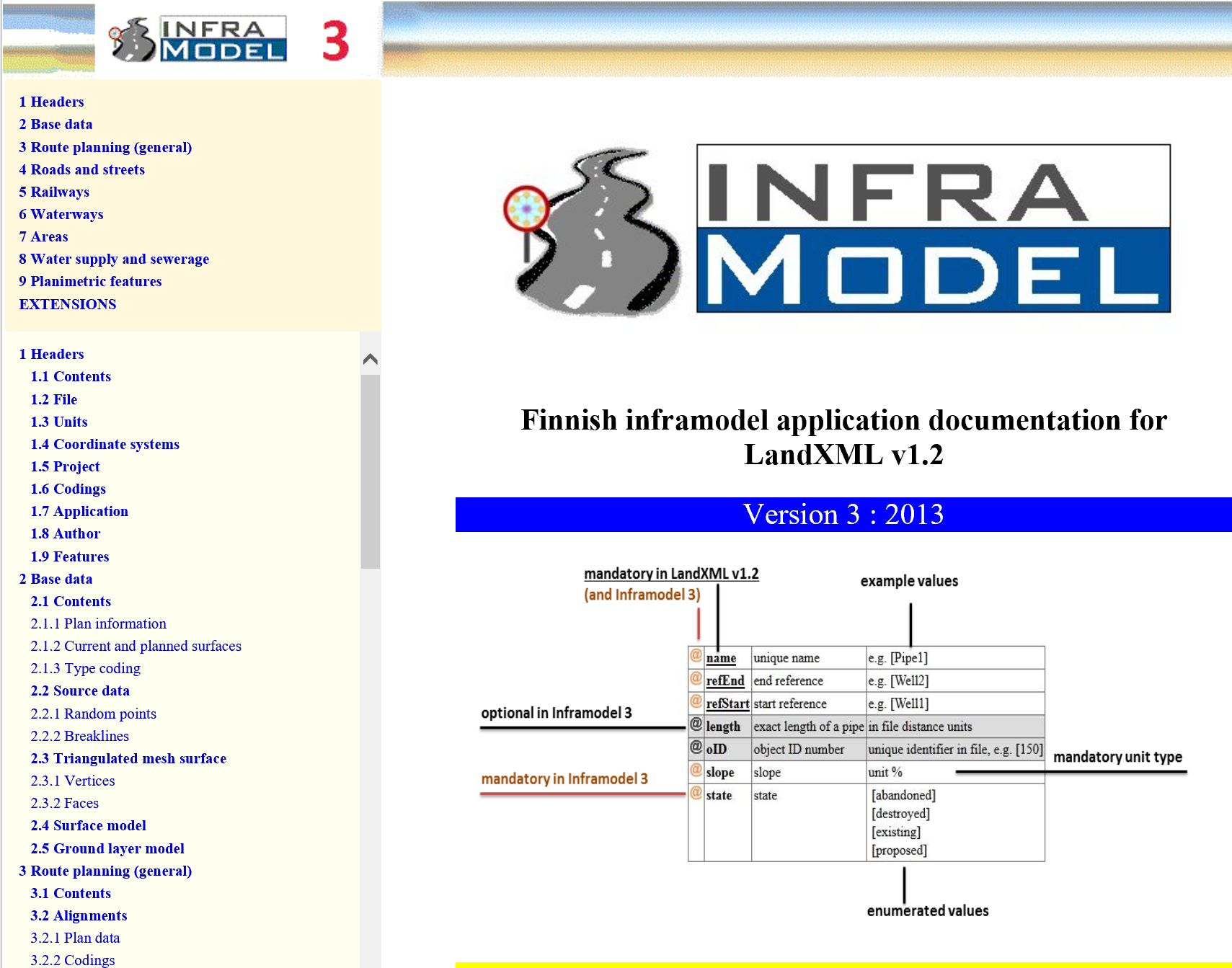
Common InfraBIM Guidelines
InfraBIM Classification System
’The language’
InfraBIM Terminology
InfraBIM Requirements
YIV Yleiset Inframallivaatimukset
What and how to model in different phases
the updating will be published 3/2019
Open Data Exchange
Inframodel4 (LandXML)
IFC (bridges, engineering constr.)
Infra-format for bore hole data
GML
Notes:
There are the main results of InfraFINBIM and the three main pilars of InfraBIM were
InfraBIM-classification system
InfraBIM modelling requirements
Inframodel data tranfer; and as you see for bridges we have used IFC allready earlier
By the data delivery these things have to be in order

Slide 3
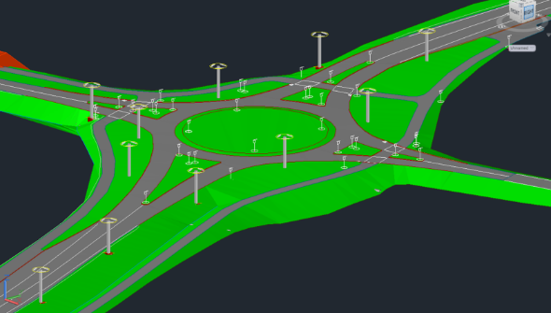
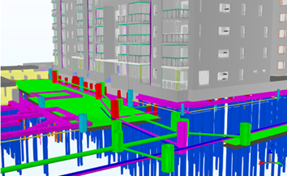
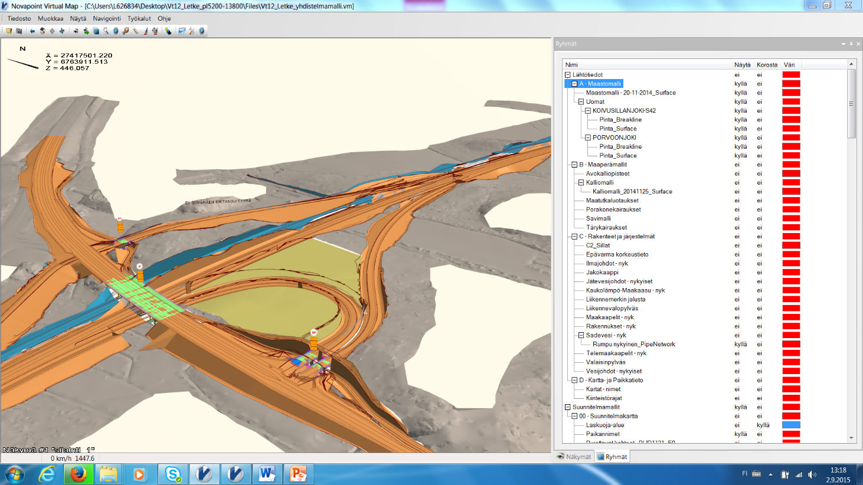
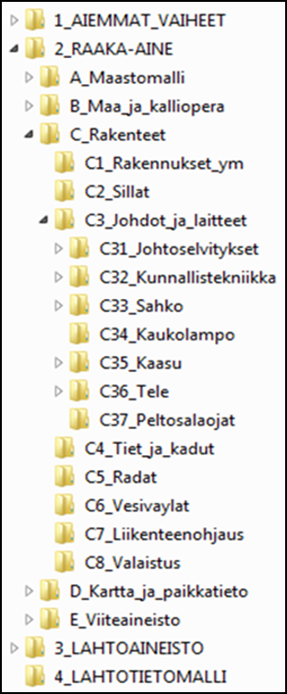
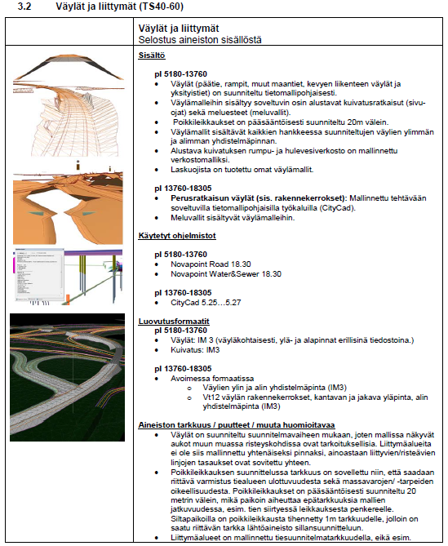
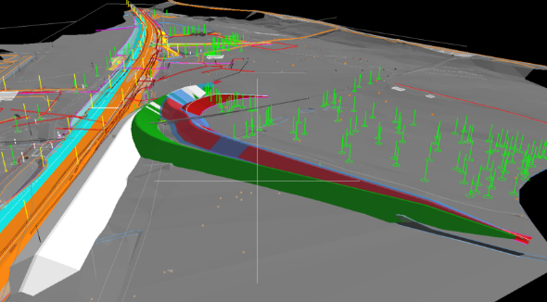
Standardized Structure for Information and Documentation, Standardized Data Transfer
Notes:
So once again OpenBIM approach
Standardized structure for information and documentation
Suitable for alla kind project
Software independent

Slide 4
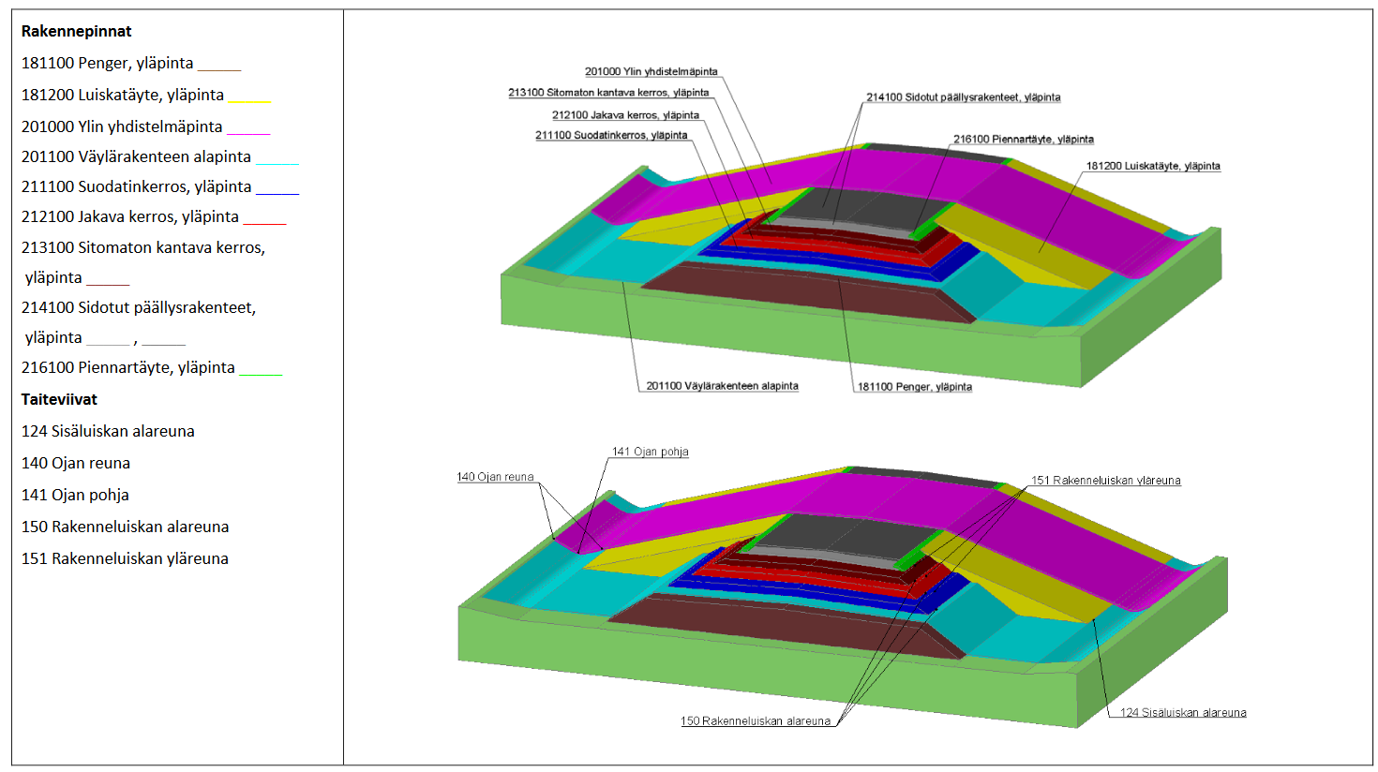
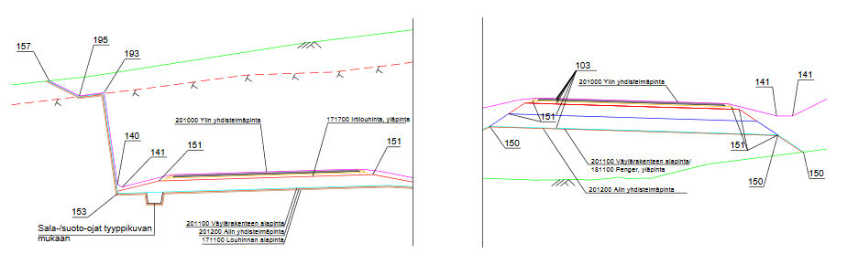
InfraBIM Classification
Unified numbering and designation practice for infrastructure models throughout life cycle
Numbering system is compatible with building element classification
Main role in construction layers and surfaces and string lines
https://buildingsmart.fi/infrabim/infrabim-nimikkeisto/
Notes:
InfraBIM Classification is developed in the Infra FINBIM program in 2012
The goal is to have a unified numbering and designation practice for infrastructure models throughout life cycle
The numbering system of surfaces is compatible to building element classification. So it is based to the building elements, but it do not fullfill all needs of information modelling
In the classification main role is in construction layers and surfaces and the string lines
InfraBIM classification includes 3D and cross section pictures for visualisation

Slide 5
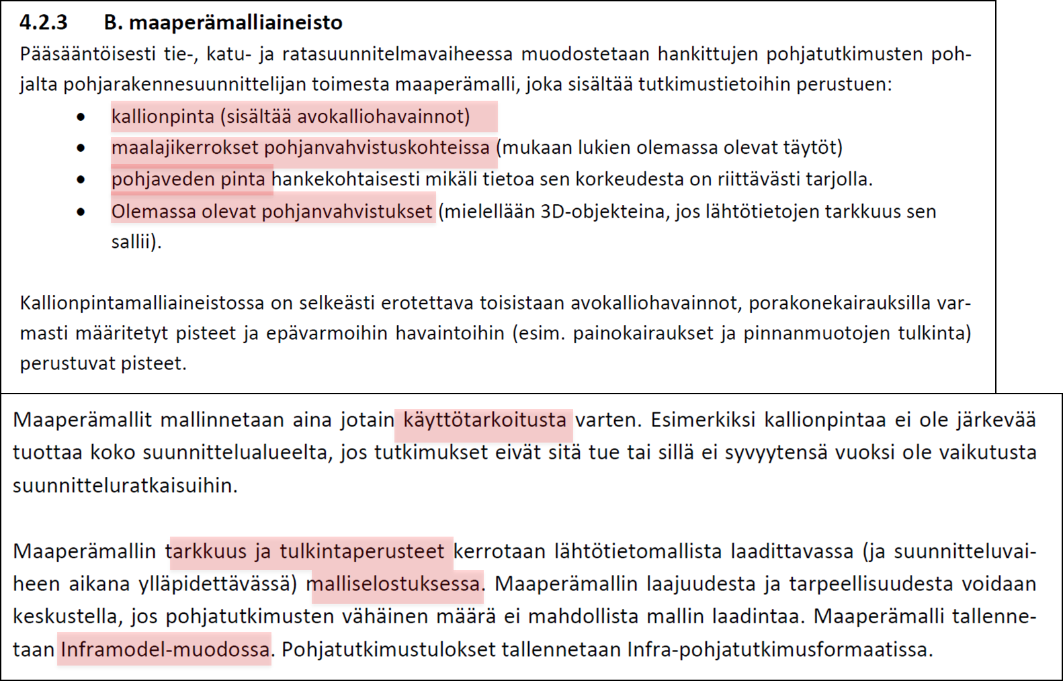
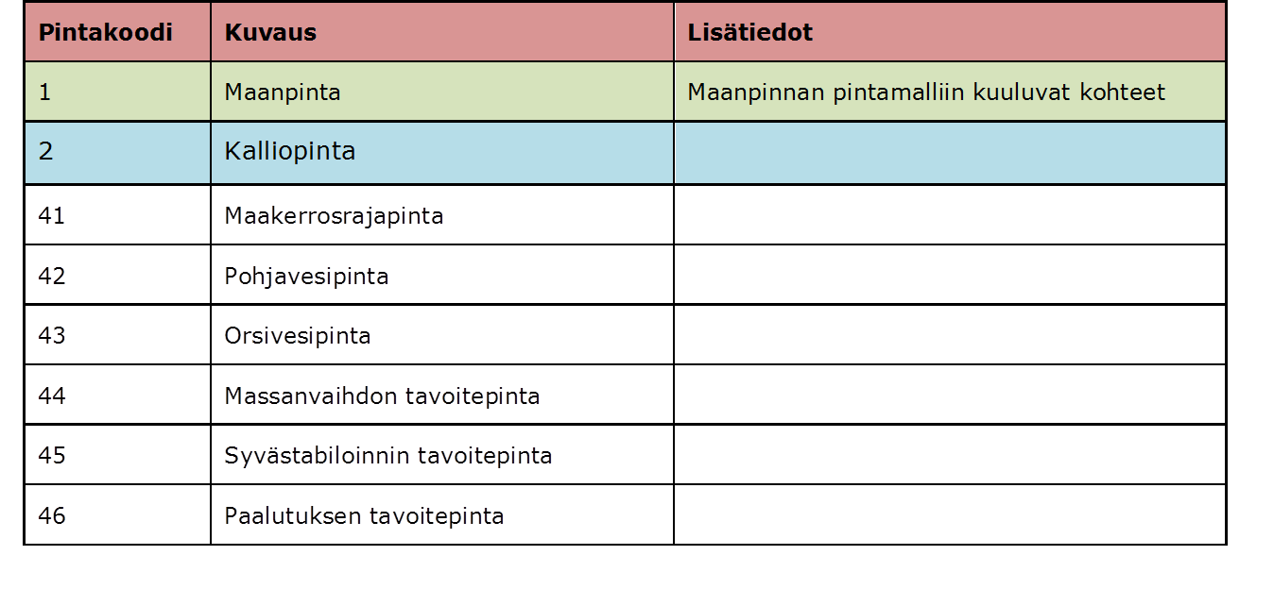
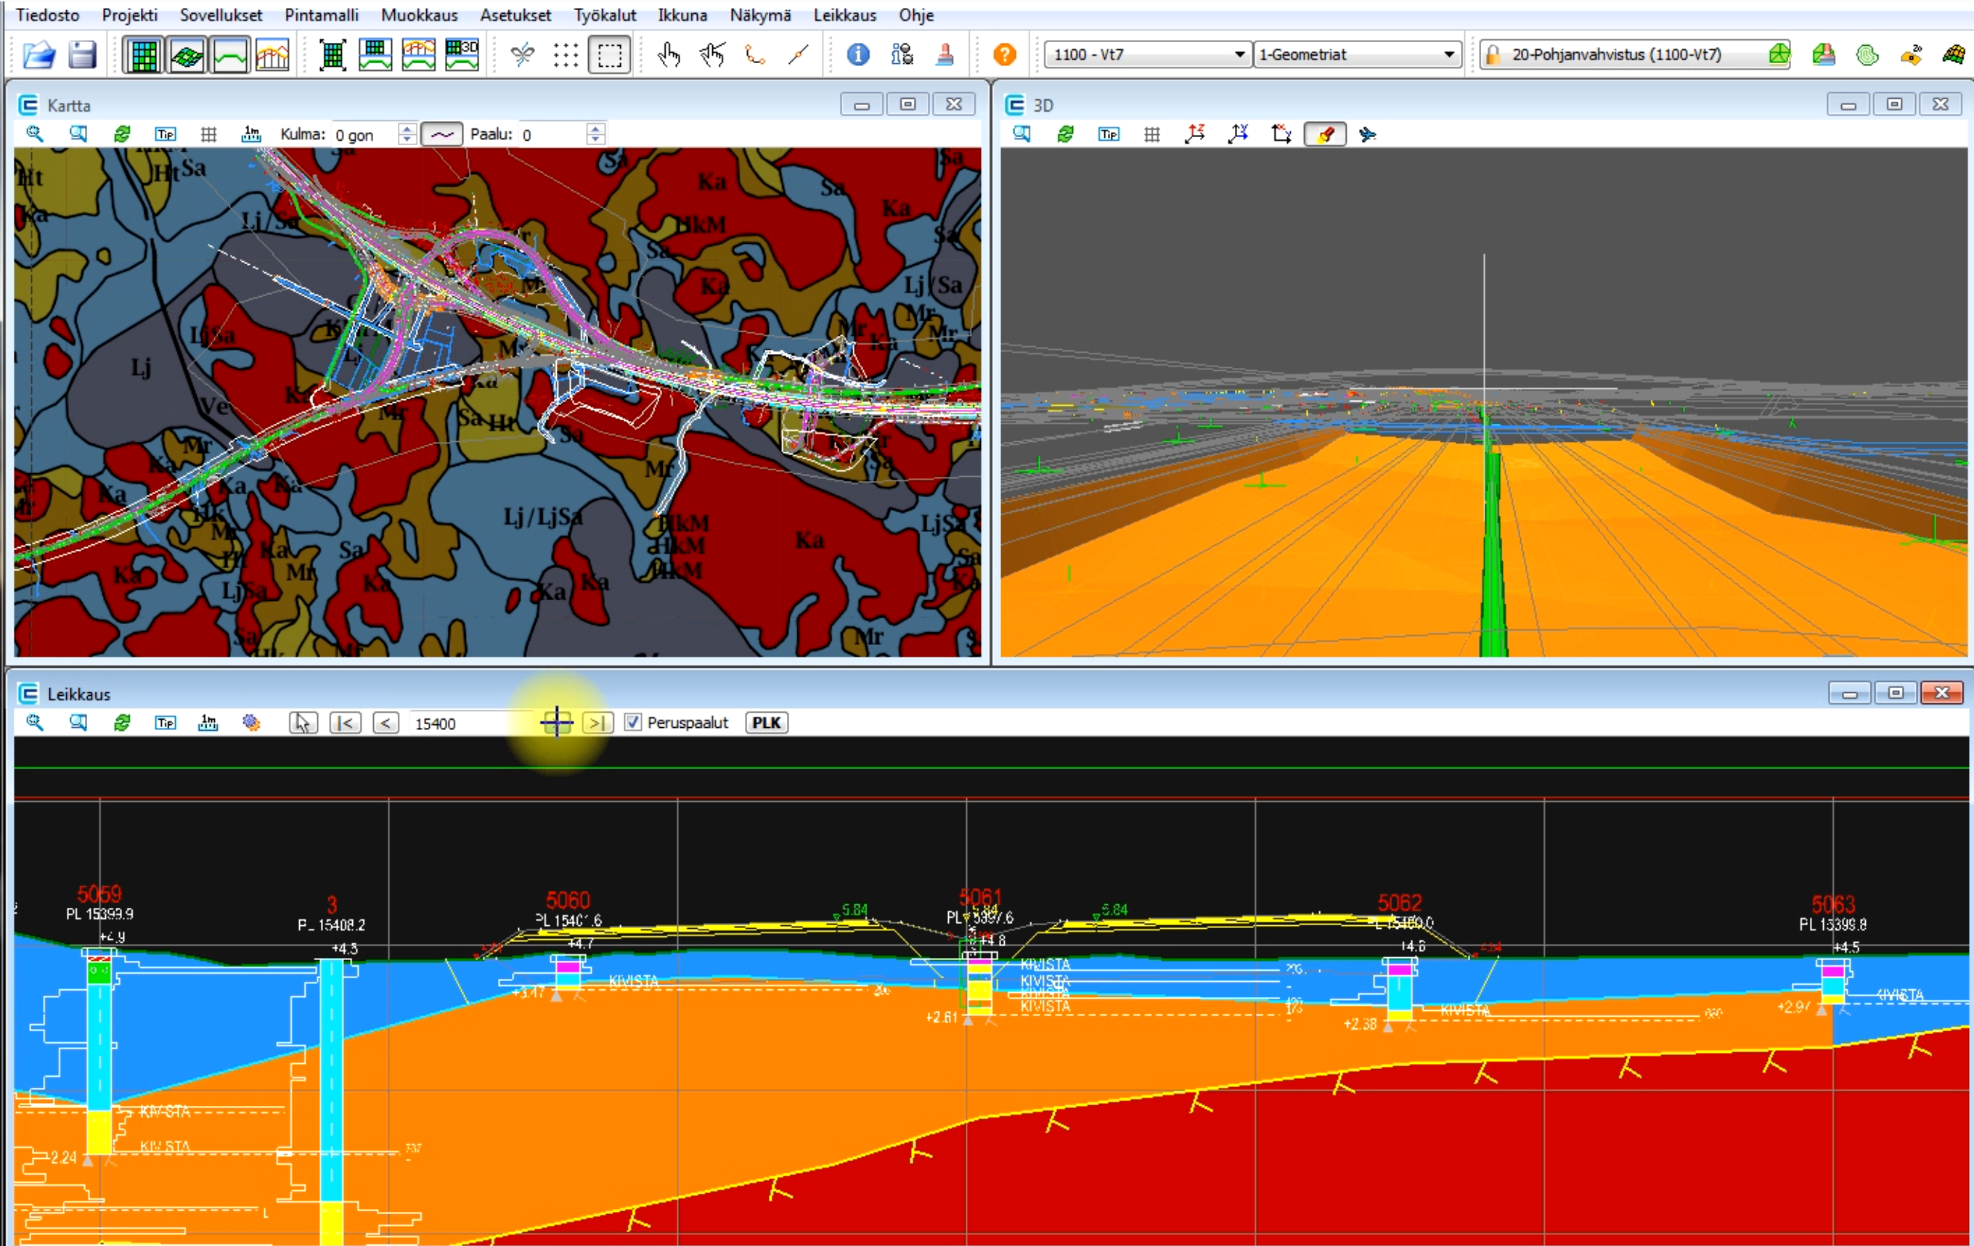
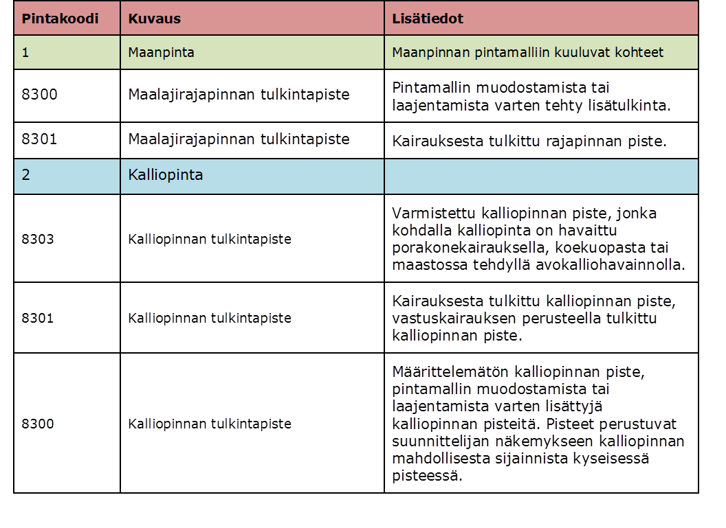
InfraBIM Classification – subsoil model
Surface types
Soil surfaces
Rock surface
Target surfaces
Interprection codings

Slide 6
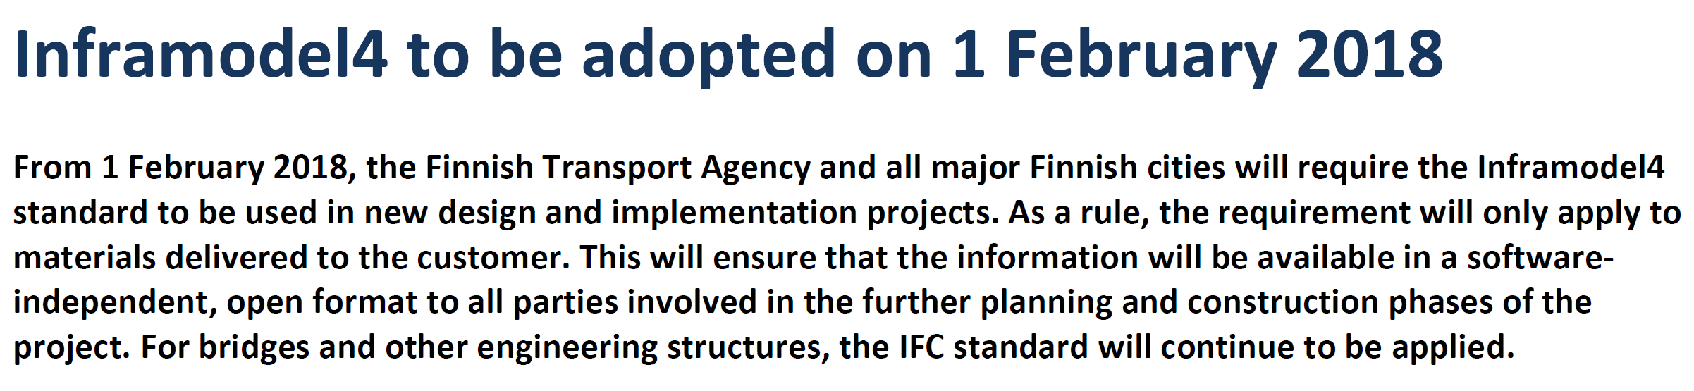
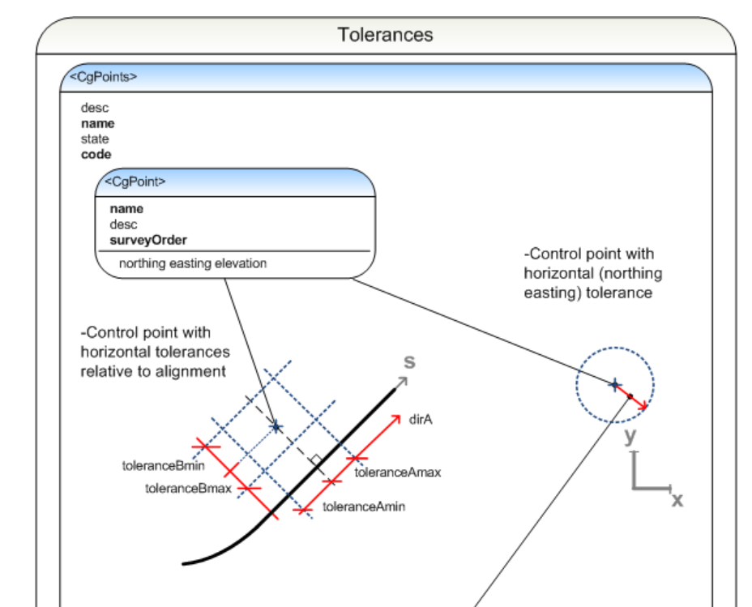
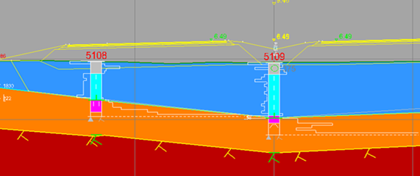
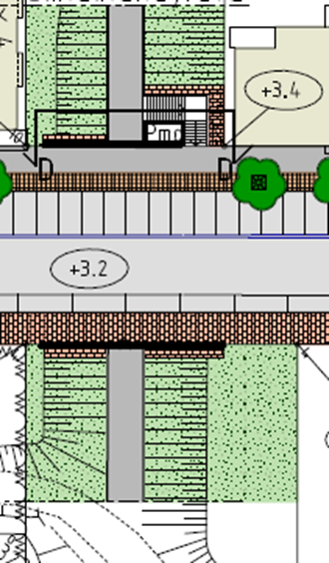
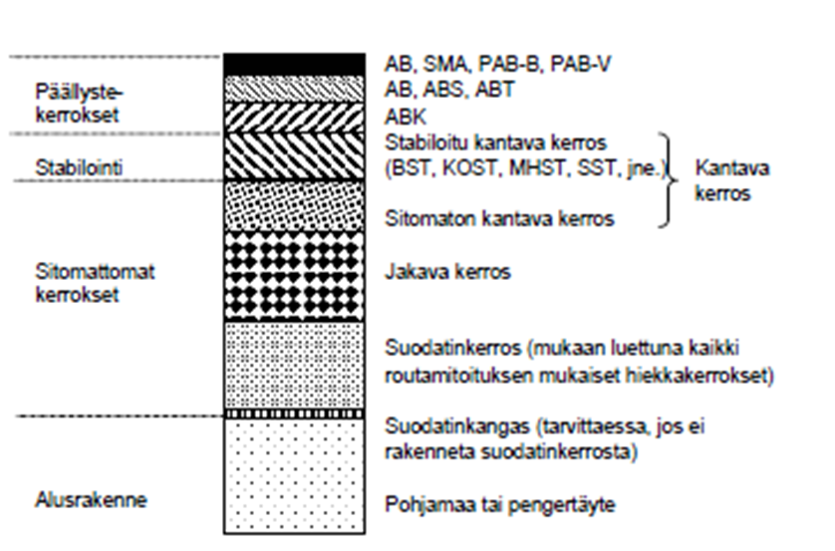
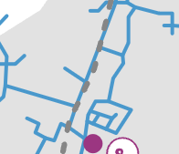
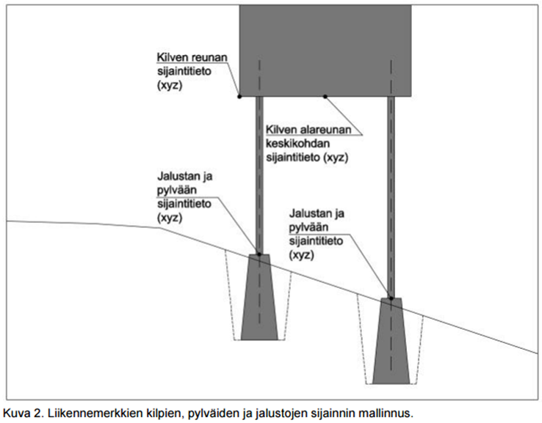
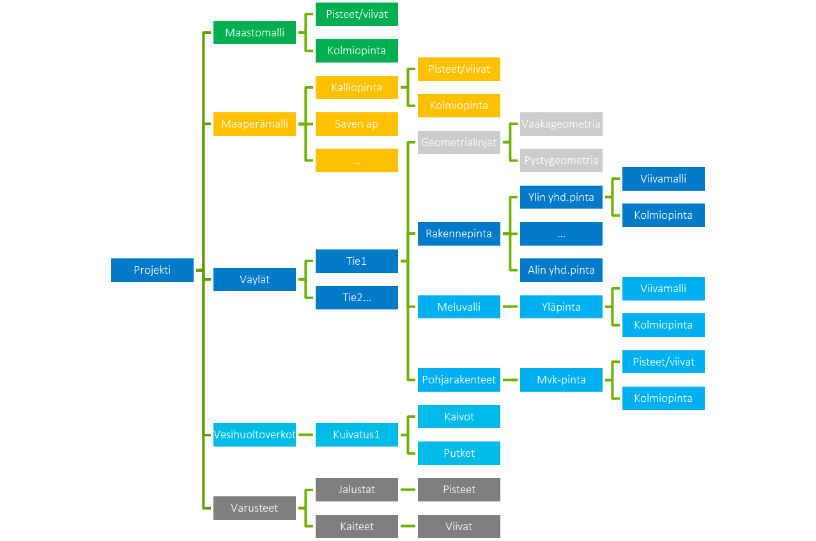
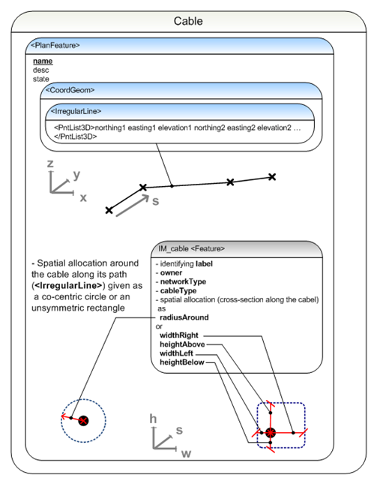
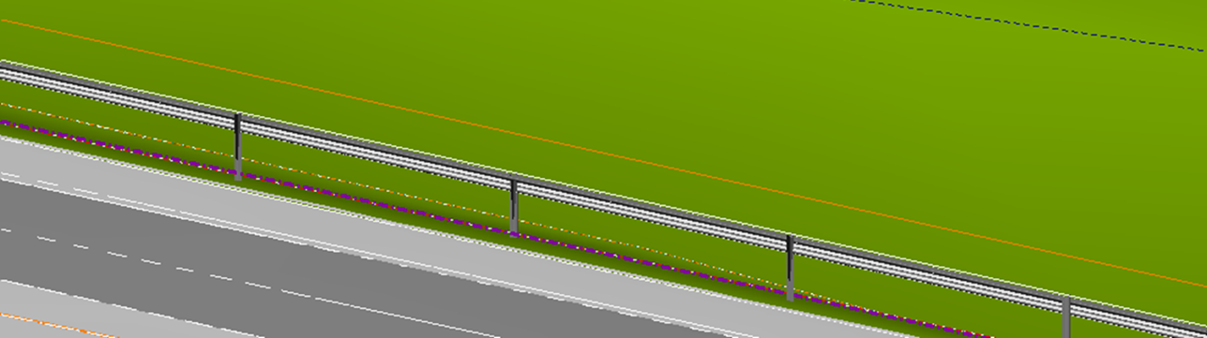
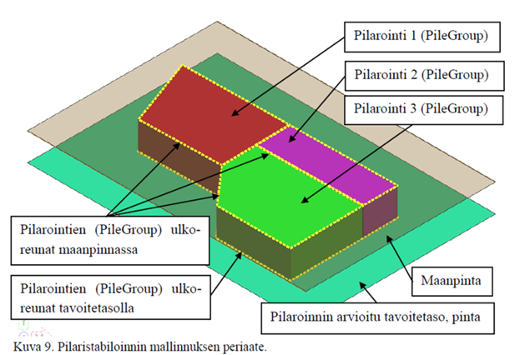
Inframodel3 > Inframodel4
As-built data
Sub soil model
Surface structures
Structural surfaces: fences and railings
Lower surface of the structure
Line models of structures
Lower surface of clay
Upper surface of the structure
Complete model
Ground, lower surface of the clay
Upper surface line model
Drying, bases
Structural layers
New network types
Bases
Wire and cable routing
Railings and fences
Column stabilisation
20.1.2019
Notes:
And Inframodel, I have to mention that
Now we’ll take the next step Inframod4, it includes new parts ans properties, e.g. materils, networks, …
Inframodel development has also served as a very good foundation to understand and act to the international standardization.
With that we have influenced also to IFC ’Infra’ development

Slide 7
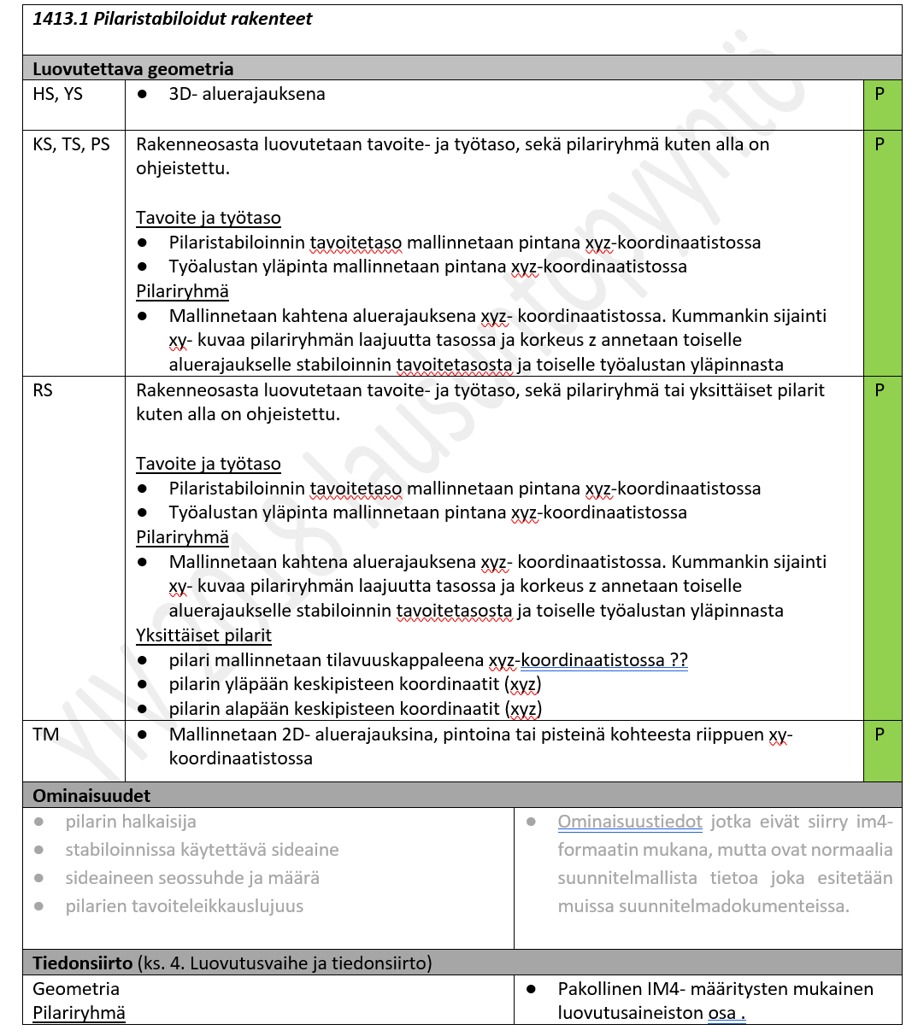


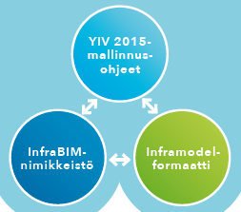
Common InfraBIM Requirements 2018
1. Common
2. Intial State
3. Plan & Design
4. Construction
5. Maintanance
20.1.2019
Yleiset tietomallivaatimukset ja -ohjeistukset
InfraBIM Guidelines Juha Liukas
https://buildingsmart.fi/yleiset-inframallivaatimukset-ohjeiden-paivitys-lausuntopyynto-yiv-2018/

Slide 8
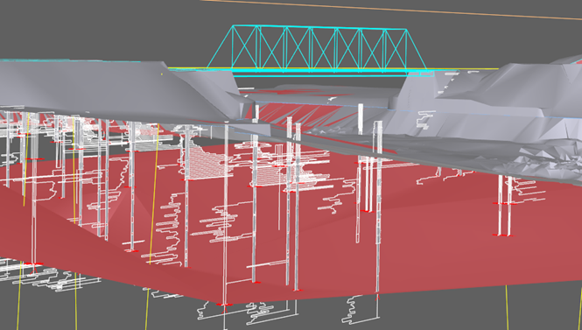
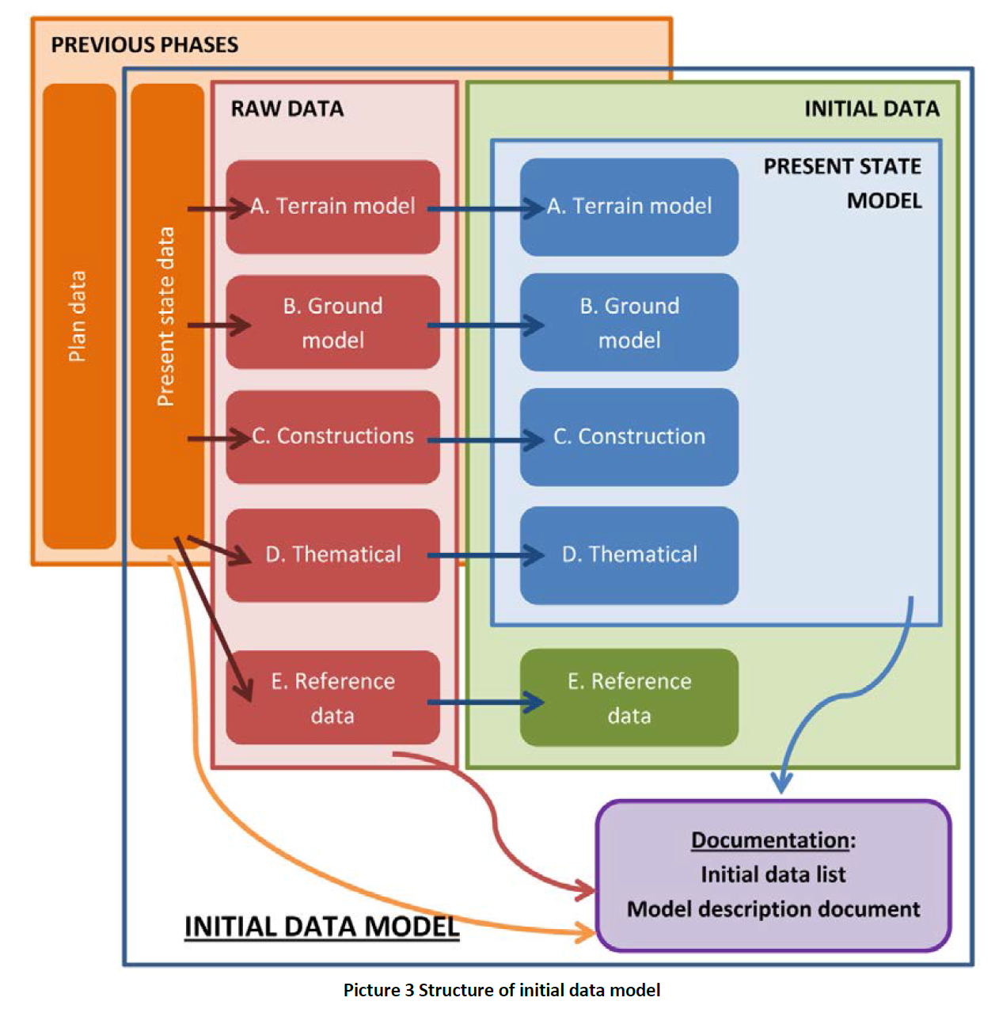
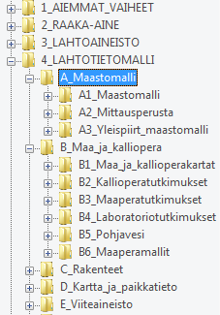
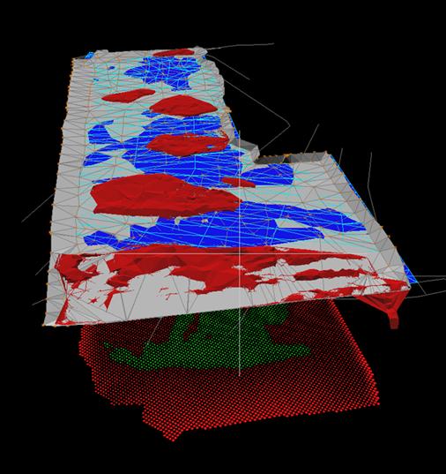
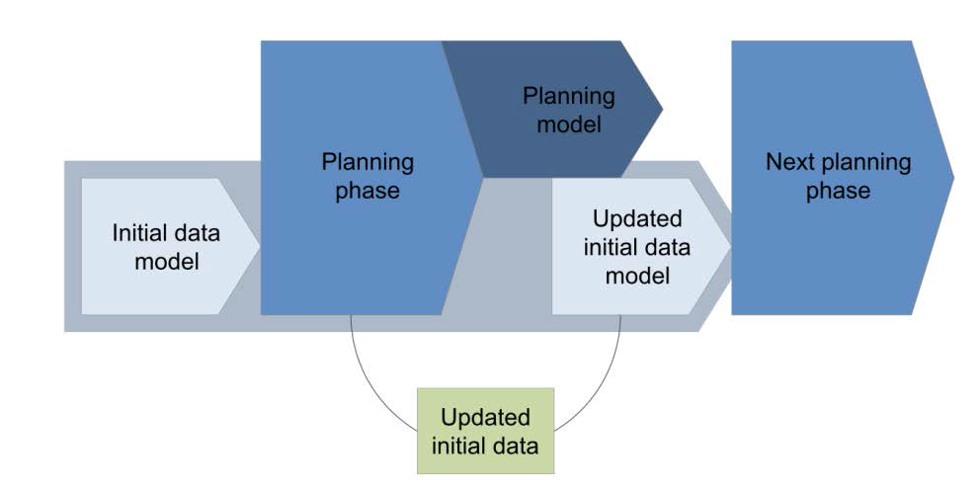
Intial State model

Slide 9
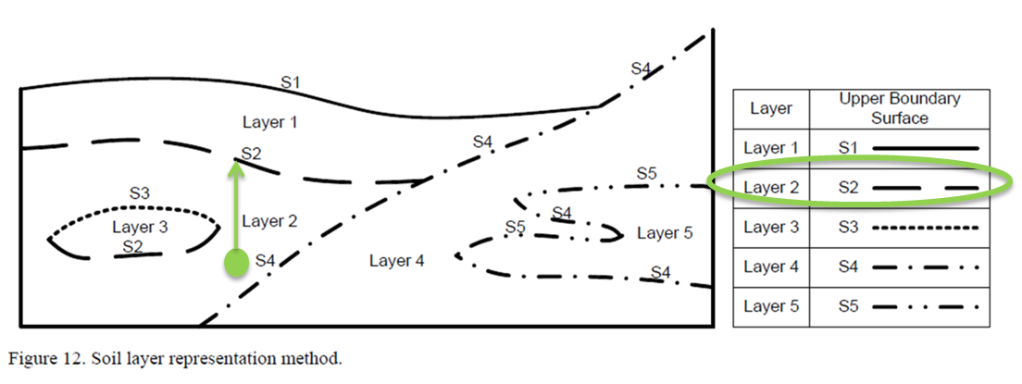

Inframodel4 – Subsoil model – soil properties
TIN surfaces between layers (interprediction points and lines)
GEO-soiltype: Tv, Sa, Si, Hk, SrMr, siMr, …
Quality for construction: S1-S4, H1-H4, U1-U4
Frost cofficient
E-modul
N. Yabukin Representation of caves in a shield tunnel product model
<Feature code="IM_coding" source="inframodel">
<Property label="surfaceCoding” value=”31” />
<Property label="surfaceCodingDesc” value="Maalajirajapinta” />
<Property label="soilTypeGEO" value="Si" />
<Property label="soilTypeISO" value="Ci" />
<Property label=”qualificationClass" value=”U3" />
<Property label=”frostSwellingFactorWet" value=”6" />
<Property label=”elasticModulusWet" value=”10" />
</Feature>
InfraBIM Guidelines
20.1.2019 Juha Liukas

Slide 10
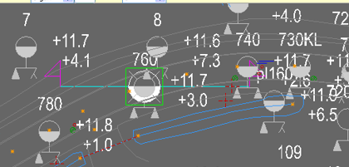

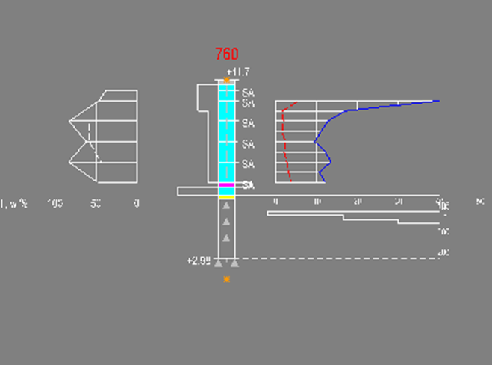
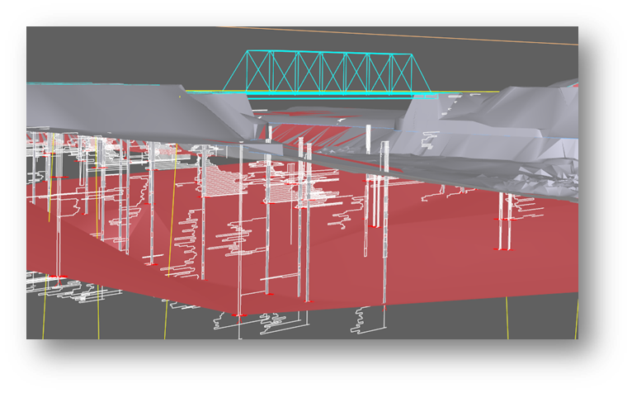
Borehole data Infra-format National standard
TT PA 1 -
XY 74767.910 34397.400 11.680 20051991 760
.000 .00 0
.200 .00 0 Hm
1.500 50.00 0 Sa
5.000 25.00 0
5.200 100.00 8 Si
5.600 100.00 0 Sa
5.800 100.00 100 Hk
5.900 100.00 100 Ki
6.400 .00 -5
6.600 100.00 16
6.800 100.00 53
7.000 100.00 80
7.100 100.00 100
8.000 .00 -5
8.100 100.00 100
8.700 .00 -5
-1 KI
TT NE 1 -
XY 74767.910 34397.400 11.680 20051991 760
.500 - .500 SA
LB w 37.800 %
1.000 - 1.000 SA
LB w 46.200 %
2.000 - 2.000 SA
LB w 82.300 %
LB F 57.600 %
LB VG 15.300 kN/m3
3.000 - 3.000 SA
LB w 61.700 %
LB F 57.600 %
LB VG 16.500 kN/m3
4.000 - 4.000 SA
LB w 82.900 %
LB F 43.800 %
LB VG 15.100 kN/m3
5.000 - 5.000 SA
LB w 47.600 %
LB VG 17.100 kN/m3
-1
TT SI 1 -
XY 74767.910 34397.480 11.650 11091991 760KL
1.000 40.00 5.80 .00
1.500 17.00 1.60 .00
2.000 12.70 1.90 .00
2.500 11.10 1.60 .00
3.000 9.50 2.40 .00
3.500 12.20 2.10 .00
4.000 13.50 2.70 .00
4.500 10.60 3.20 .00
5.000 12.20 3.70 .00
InfraBIM Guidelines
20.1.2019 Juha Liukas

Slide 11
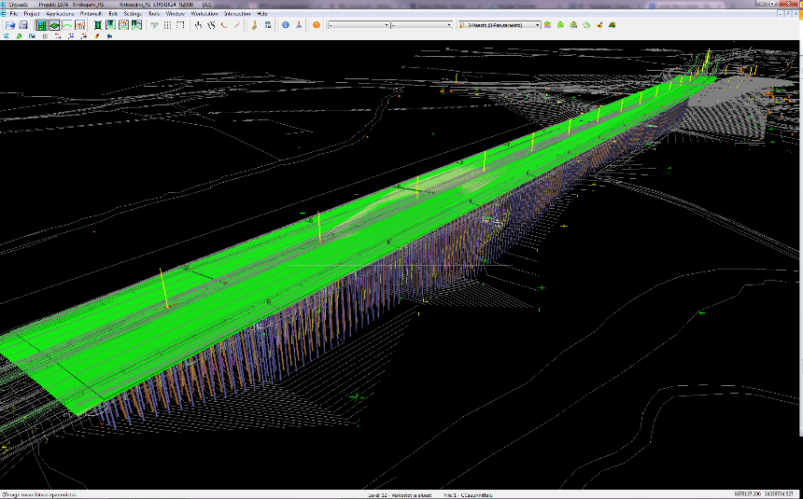
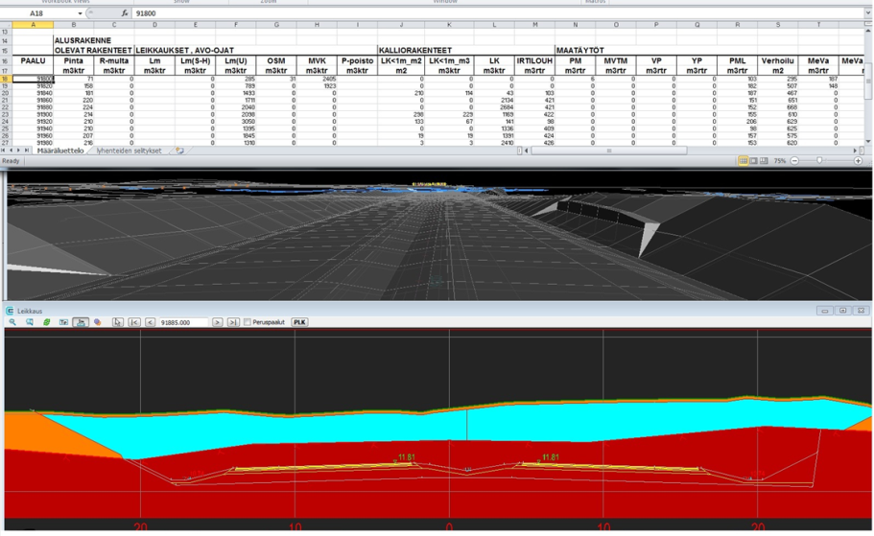
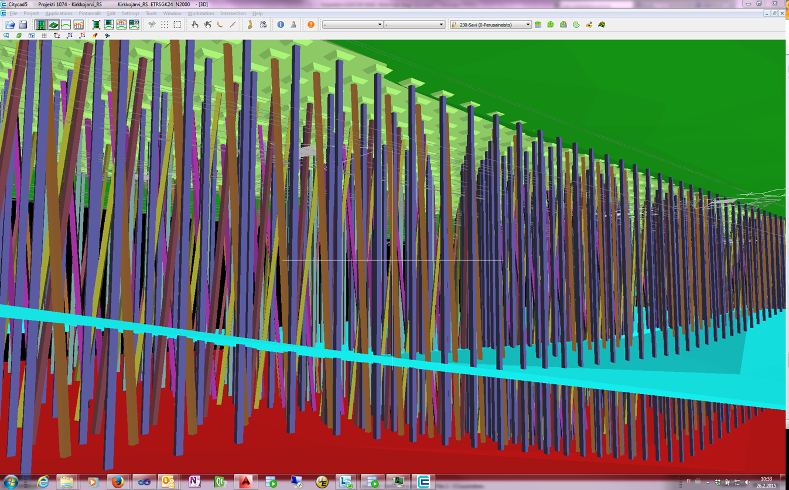
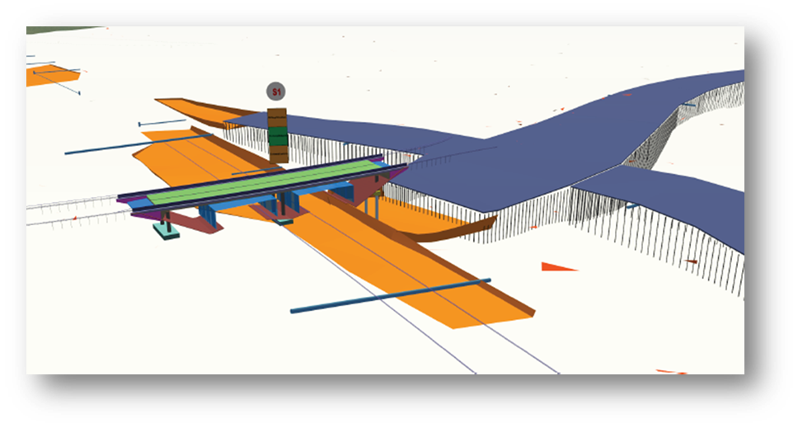
Subsoil model – utilising
Target surfaces
Road/rail construction – subsoil integration
Bridge / engineering structures - subsoil
QTO quantity take off
Geotechnical calculation
Machine quidance

Slide 12
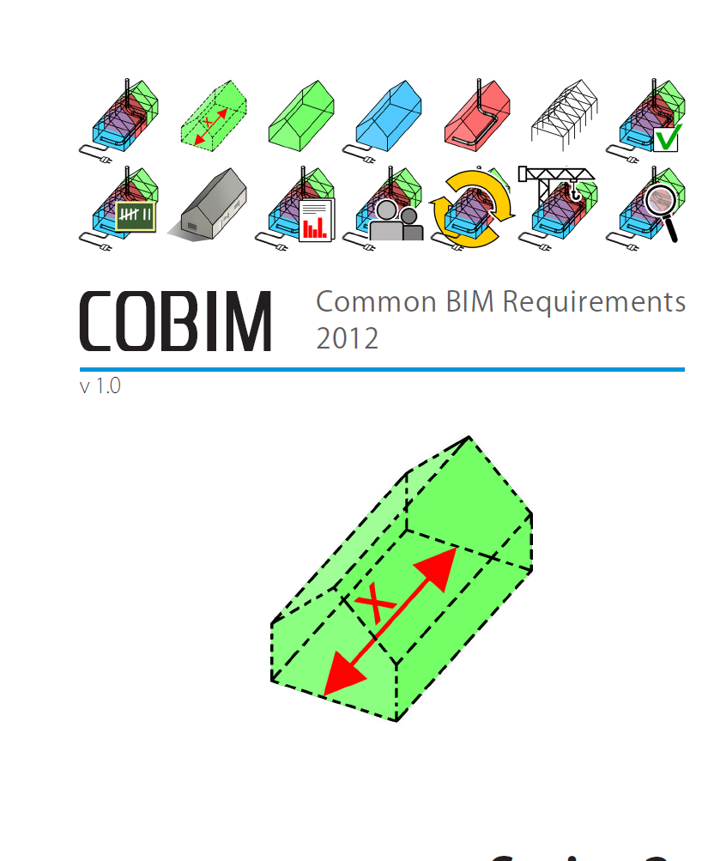
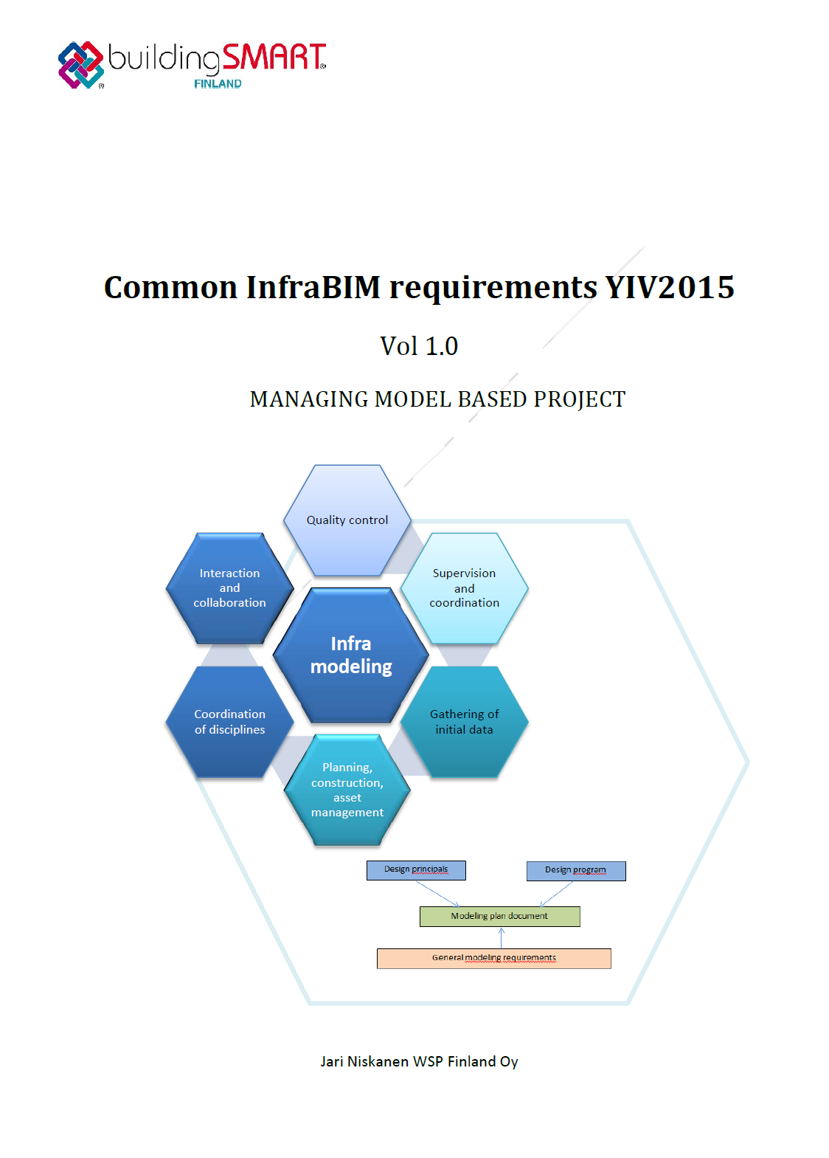
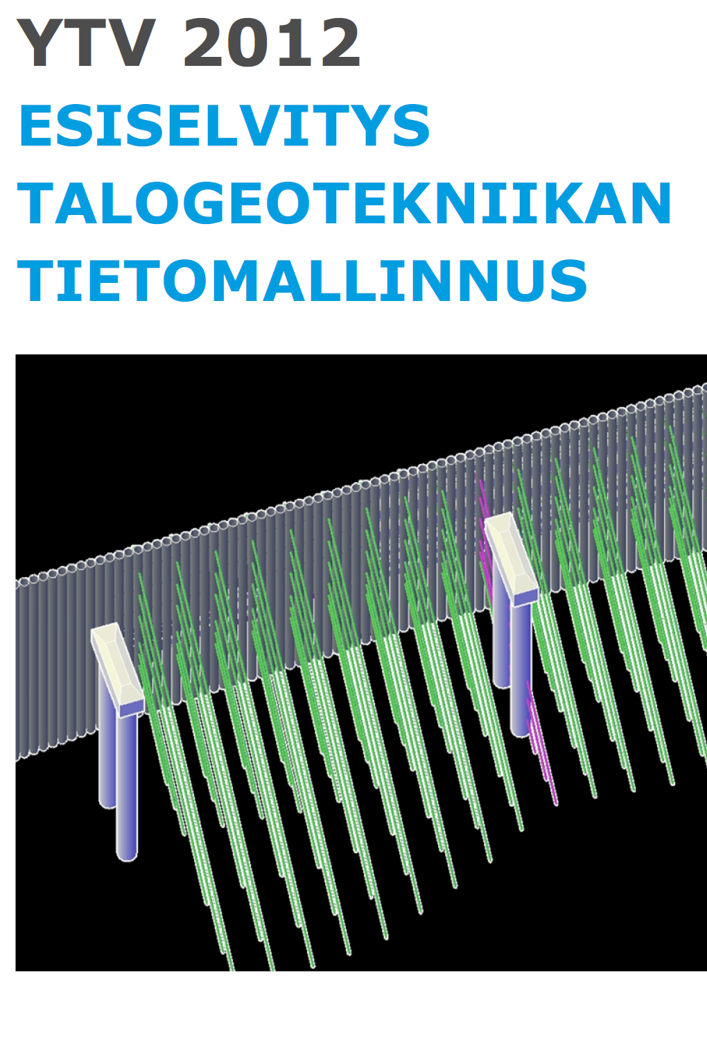
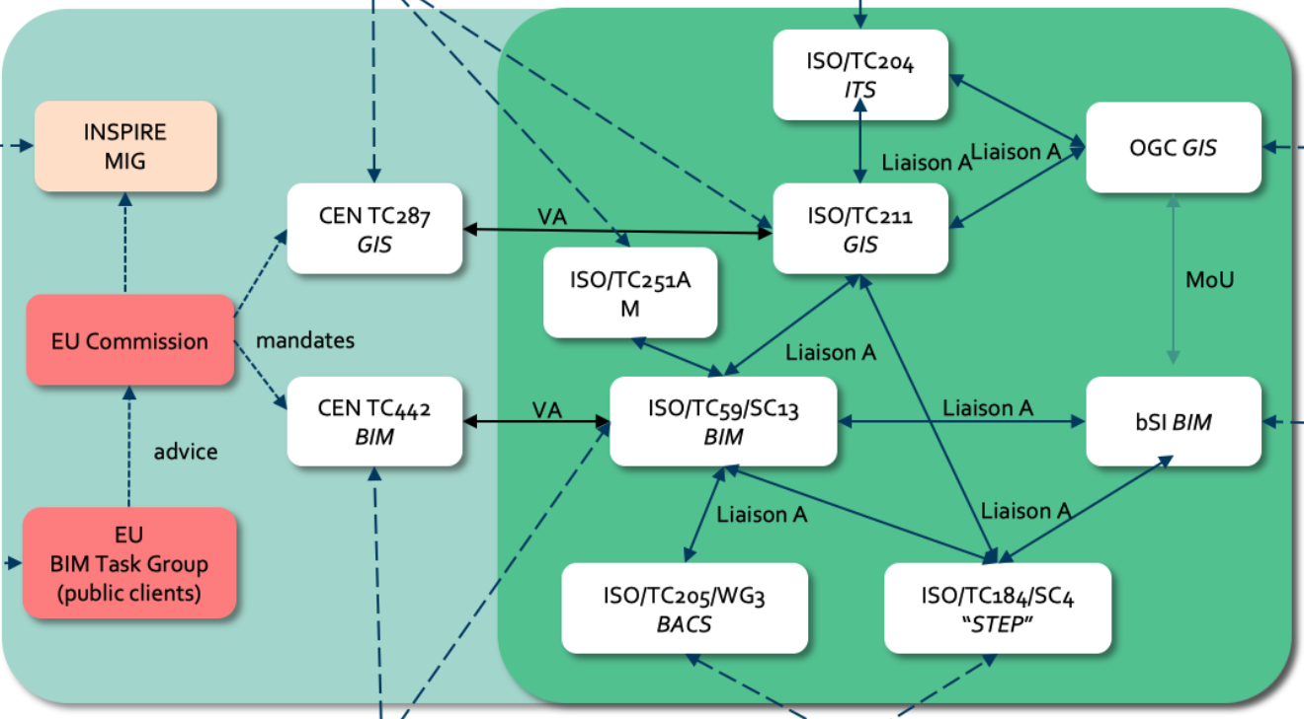
Future Challenges
Geotechnical part is missing from COBIM
Consolidation of BIM- and InfraBIM -requirements
Consolidation of Talo- and Infra-classifications
The right standards ? IFC, GML, …
https://rastiprojekti.com/

Slide 13
Thank you ! Questions ?
juha.liukas(at)sitowise.com

